Slide 1
KGR-Path Based Reasoning
Illustration of Experiments in a Trouble Shooting context using Curl (AAAI-2021)

Slide 2
Design Experiment (Static KG)
Auto Recovery
Replace jumper
Reset RRU
RRU
inv_associated
T1
last_activity
inv_associated
Action_perf
Cable
Action_perf
Has_root_cause
inv_associated
W2
Training/Test
Action_perf
W1
NW
W4
Has_root_cause
Others
T1 | Is_related | W1
T2 | Is_related | W2
T3 | Is_related | W3
T2
Occurred_at
Has_root_cause
Associated_with
W3
Occurred_at
Weather _befr
SW
Weather _befr
Is_of_vendor
predominant_at
In_months_of
Is_of_vendor
predominant_at
Weather _befr
T3
In_months_of
Is_of_vendor
Huawei
No rain Fall
Test : Evaluate Accuracy & Extract Reasoning Paths
Train :Extract Reasoning Paths
Ericsson
Nokia
Medium Rainfall
Task : Given a se of Tickets(T) & Resolutions(W) and other entities , can we recommend explainable resolutions for a particular or type of Tickets ?

Slide 3
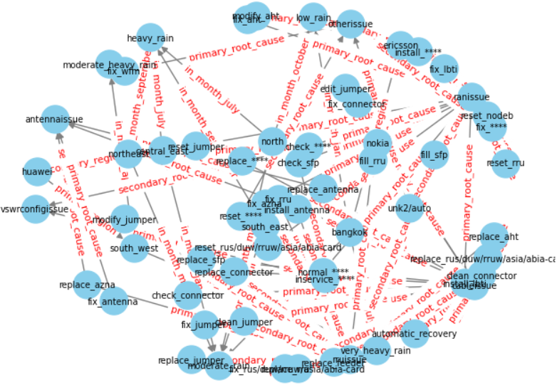
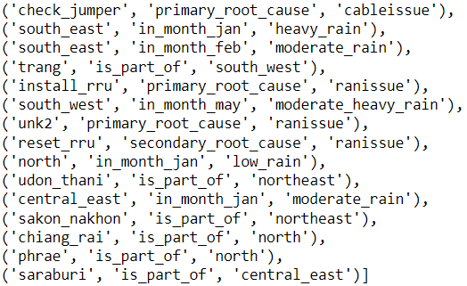
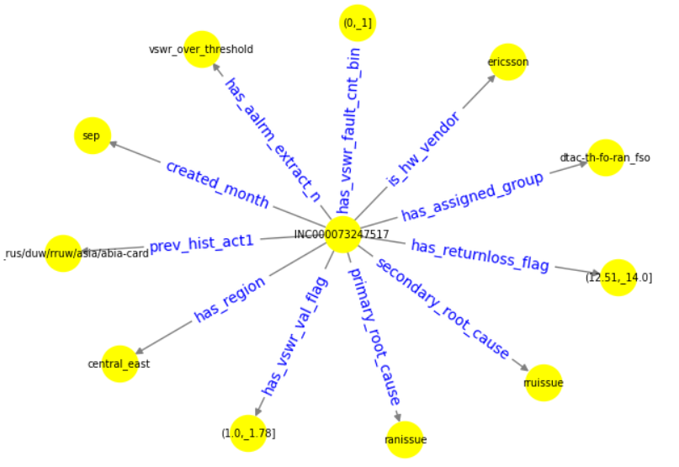
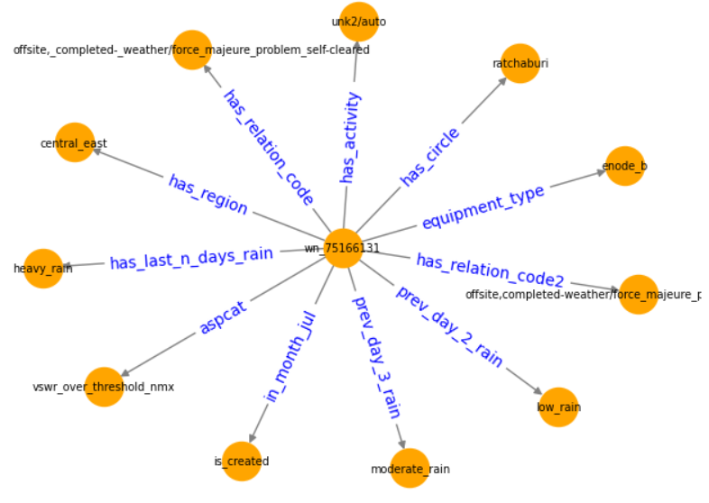
Knowledge graph
Concept Triples
Concept Triples
#Relations : 47
# Entities : 7058
# Concept Triples : 270
# Instance Triples : 83683
.
Relations
['has_rootcause', 'has_assigned_group', 'has_region', 'has_circle', 'created_month', 'is_hw_vendor', 'has_aalrm_extract_n', 'has_returnloss_flag', 'has_vswr_val_flag', 'primary_root_cause', 'secondary_root_cause', 'primary_region', 'secondary_region', 'is_part_of', 'in_month_june', 'in_month_july', 'in_month_august', 'in_month_september', 'in_month_feb', 'in_month_mar', 'in_month_april', 'in_month_may', 'in_month_october', 'in_month_nov', 'in_month_dec', 'in_month_jan', 'prev_hist_act1', 'prev_hist_act2', 'prev_hist_act3', 'equipment_type', 'aspcat', 'has_relation_code', 'has_relation_code2', 'in_month_jul', 'has_activity', 'prev_day_1_rain', 'prev_day_2_rain', 'prev_day_3_rain', 'has_last_n_days_rain', 'in_month_aug', 'in_month_sep', 'in_month_oct']
incxxxx
wofff
Ticket Triples
WorkOrder Triples

Slide 4
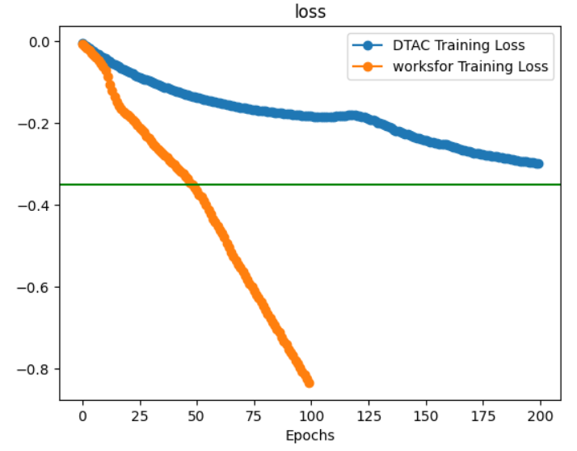
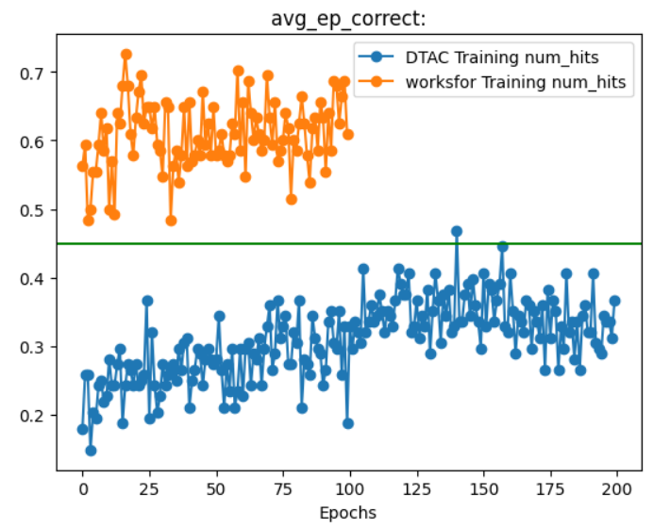
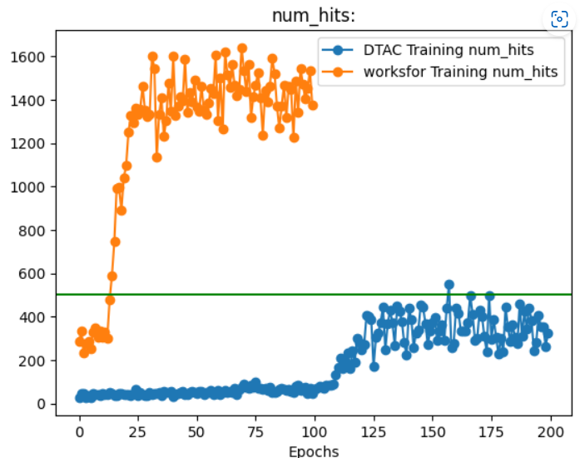
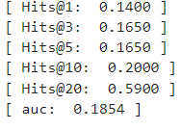
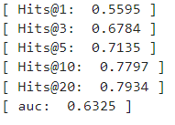
Best Model
DTAC Test Results
Worksfor Test Results

Slide 5


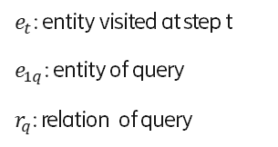
Problem-1 for TT_WO KG
Is_hw_vendor….
INC….
State:$\left(e_{t},e_{1q},r_{q }\right)$ $∈$ $R^{d}$
Inv_Is_hw_vendor….
$e_{t}$: entity visited at step t
$e_{1q}$: entity of query
$r_{q}$: relation of query
incxxxx
INCXXXX
Agent history-dependent policy ℼ
LSTM
output, new_state = lstm_cell (prev_action, prev_state)
MLP
(output || queries_ , Action ( ranked edge probabilities) )
Train using Reinforce
Actions ${ A}_{t}$ $∈$ A ; of the outgoing edges of $e_{t}$ in G; ${ A}_{t}$ $∈$ $R^{d}$
Questions that an agent is expected to answer/ reach
What is resolution for Ticket ?? : (INCXXXX,has_activity ,?,)
what is root cause for Ticket ?? : (INCYYYY,has_root_cause ,?,)
When ever agent reaches a ticket entity , should its considers all TT attributes(1-hop neighbors) entities for choosing action ??
Can we leveraged neighbor entities embeddings during learning process

Slide 6
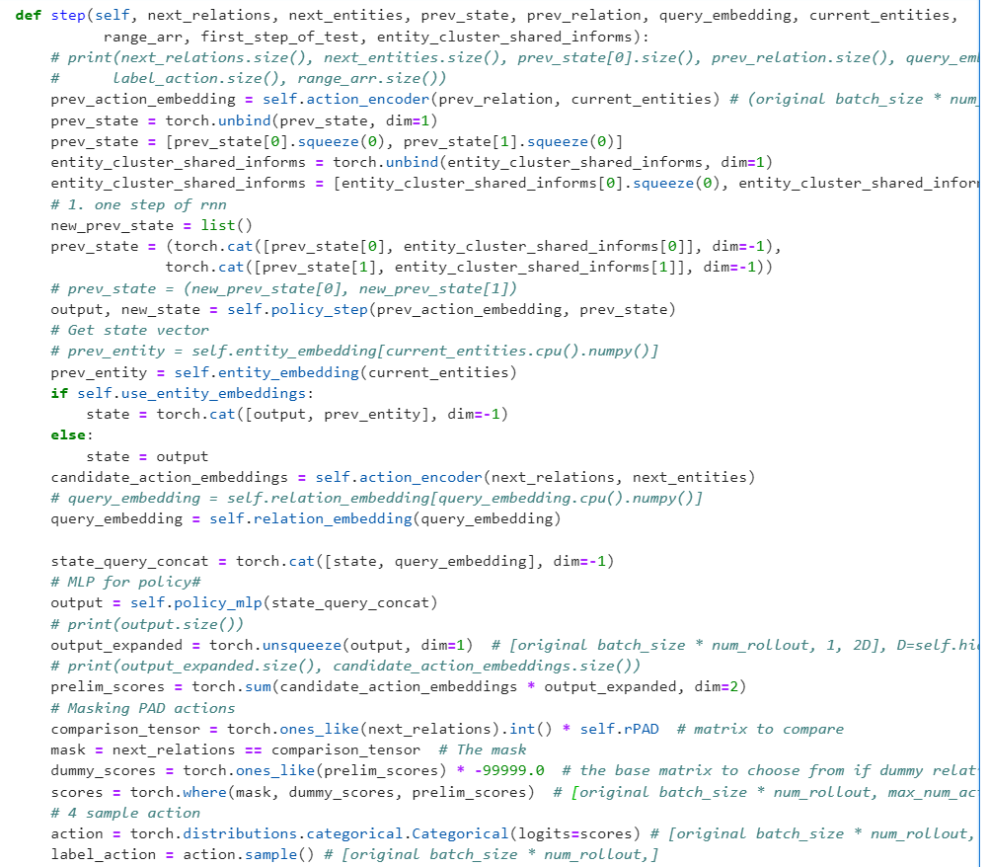

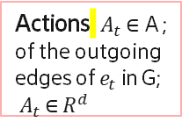

neighbor entities embeddings as a context during learning process
State:$\left(e_{t},e_{1q},r_{q }\right)$ $∈$ $R^{d}$
$e_{t}$: entity visited at step t
$e_{1q}$: entity of query
$r_{q}$: relation of query
Agent code of CURL will be modified here
Actions ${ A}_{t}$ $∈$ A ; of the outgoing edges of $e_{t}$ in G; ${ A}_{t}$ $∈$ $R^{d}$
Agent history-dependent policy ℼ
LSTM
output, new_state = lstm_cell (prev_action, prev_state)
MLP
(output || queries_ , Action ( ranked edge probabilities) )
Train using Reinforce

Slide 7
Ex: Combined Embedding neighbor entities embeddings during learning process , code modification results
INCYYYY
-1
tensor(-15.3805)
('has_assigned_group’, A'),
('has_region', 'central_east\n'),
('created_month', 'sep\n'),
('is_hw_vendor', Vendor1 \n'),
('has_aalrm_extract_n', 'vswr_over_threshold\n'),
('has_returnloss_flag', '(12.51,_14.0]\n'),
('has_vswr_val_flag', '(1.0,_1.78]\n'),
('has_vswr_fault_cnt_bin', '(-1,_0]\n'),
('equipment_type', 'enode_b\n'),
('aspcat', 'vswr_over_threshold_nmx\n'),
('in_month_sep', 'is_created\n'),
('has_activity', 'fix_rru\n')
INCXXXX has_activity ?? fix_connector
INCXXXX
INCXXXX
INCYYYY
P1
INCXXXX
('has_assigned_group’, A'),
('has_region', 'bangkok\n'),
('created_month', 'sep\n'),
('is_hw_vendor’, Vendor1\n'),
('has_aalrm_extract_n', 'vswr_over_threshold\n'),
('has_returnloss_flag', '(11.15,_12.51]\n'),
('has_vswr_val_flag', '(1.0,_1.78]\n'),
('has_vswr_fault_cnt_bin', '(-1,_0]\n'),
('equipment_type', 'node_b\n'),
('aspcat', 'vswr_over_threshold_outside_time_window_nmx\n'),
('in_month_sep', 'is_created\n'),
('has_activity', 'fix_jumper\n'),
('prev_day_1_rain', 'moderate_rain\n'),
('has_last_n_days_rain', 'moderate_rain\n')'
P1, P2 are two rollouts (paths ) traversed by agents it can be seen providing neighboring nodes as context is forcing agent to move across similar tickets, needs further validation
INCZZZZ
1
tensor(-15.3825)
('has_assigned_group’, A'),
('has_region', 'central_east\n'),
('created_month', 'sep\n'),
('is_hw_vendor', Vendor1 \n'),
('has_aalrm_extract_n', 'vswr_over_threshold\n'),
('has_returnloss_flag', '(12.51,_14.0]\n'),
('has_vswr_val_flag', '(1.0,_1.78]\n'),
('has_vswr_fault_cnt_bin', '(-1,_0]\n'),
('equipment_type', 'sran_-_single_radio_access_network_-_ Vendor1 _-_4g\n'),
('aspcat', 'vswr_over_threshold_outside_time_window_nmx\n'),
('in_month_sep', 'is_created\n'),
('has_activity', 'fix_connector\n’)
INCXXXX
INCXXXX
INCZZZZ
P2

